Slide 1

LESSON 4 – Warranties
For my sweetheart

Slide 2

characteristic
Your characteristic is so cute.

Slide 3
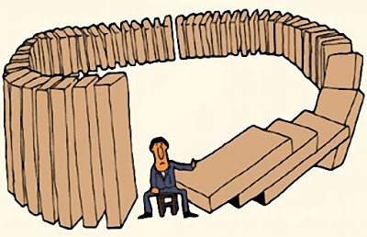
consequence
As a consequence of not having seen a dentist for several years, you had a cavity.

Slide 4
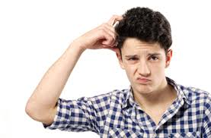
consider
I consider to become a millionaire in the future.

Slide 5
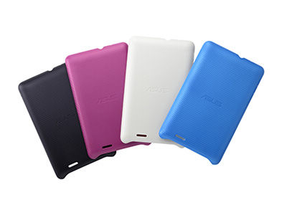
cover
I’ll cover your whole life

Slide 6

expiration
Date expiration

Slide 7


frequently
I visit you frequently

Slide 8
imply
The guarantee on the Walkman implied that all damages were covered under warranty for one year

Slide 9
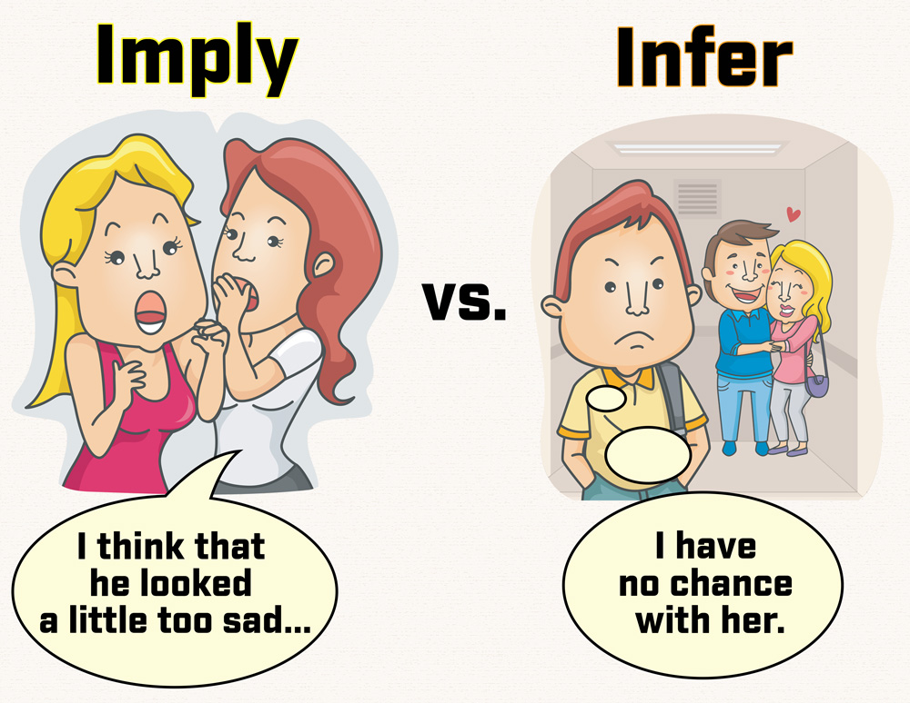

Slide 10
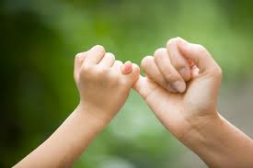
promise
I promise I always make you happy.

Slide 11

protect
I’ll protect you everyday

Slide 12

reputation
The reputation of facebook is very large

Slide 13

require
I require you give me a requirement

Slide 14
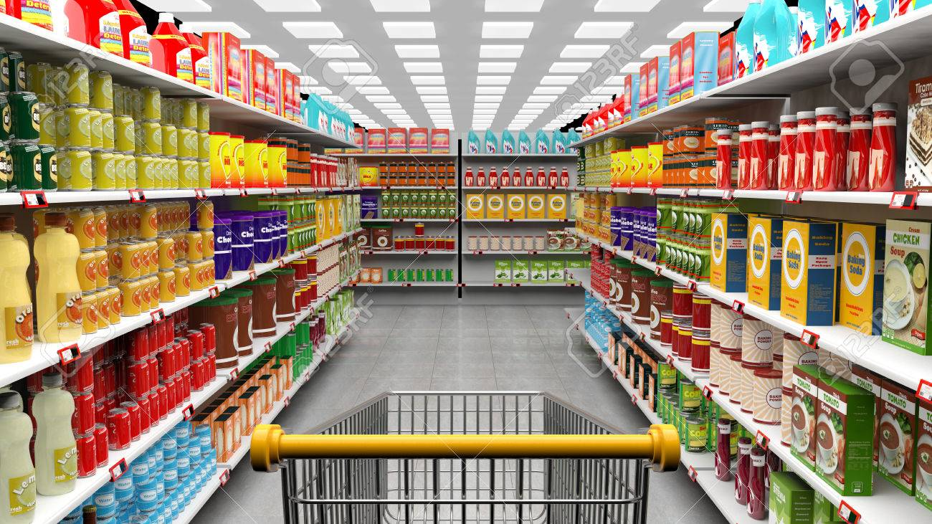
variety
There’s a variety of goods in the supermarket

Slide 15

That’s all

Slide 16
Thanks!
Any questions?
You can find me anytime

